Slide 1
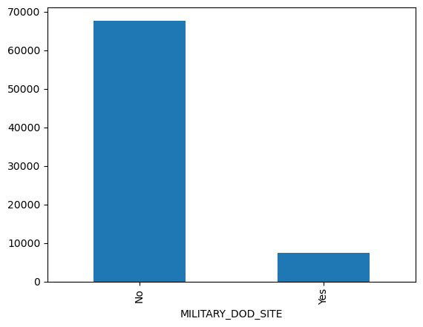
The Military Sites:

Slide 2
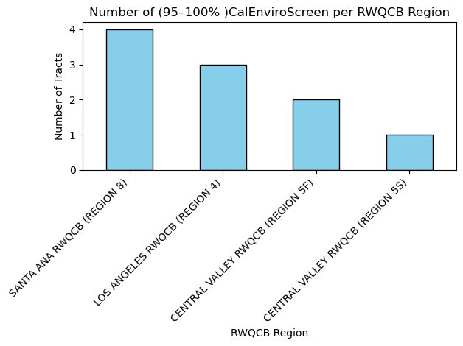

Slide 3
This chart show the RWQCB region with the most polluted water source using the
CalEnviroScreen 4.0 tool which can collect this data about the environment. So this means the regions shown are disadvantaged communities which can be caused by land or the population.

Slide 4
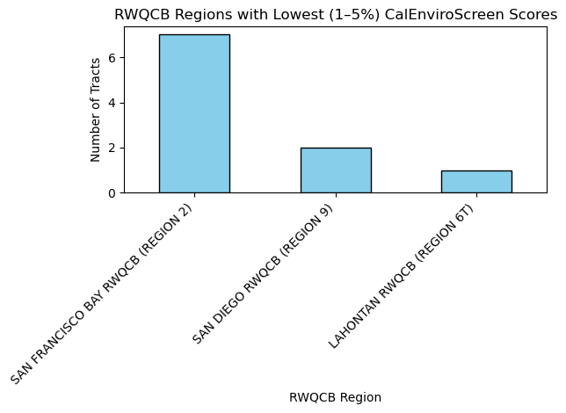

Slide 5
The CalEnviroScreen 4.0 shows here the regions that have low scores that means they have no problem in their environment also the water quality is clean useable for the people.

Slide 6
CALENVIROSCREEN3_SCORE | CALENVIROSCREEN4_SCORE
16-20% | 35-40%
91-95% | 95-100%
36-40% | 35-40%
76-80% | 80-85%
81-85% | 80-85%
21-25% | 40-45%
66-70% | 70-75%

Slide 7
CalEnviroScreen 3.0 and CalEnviroScreen 4.0 the purpose use of it is the same which identify disadvantaged communities but in 4.0 is the updated version which includes updated demographic data and new data sources in their calculations.

